Slide 1
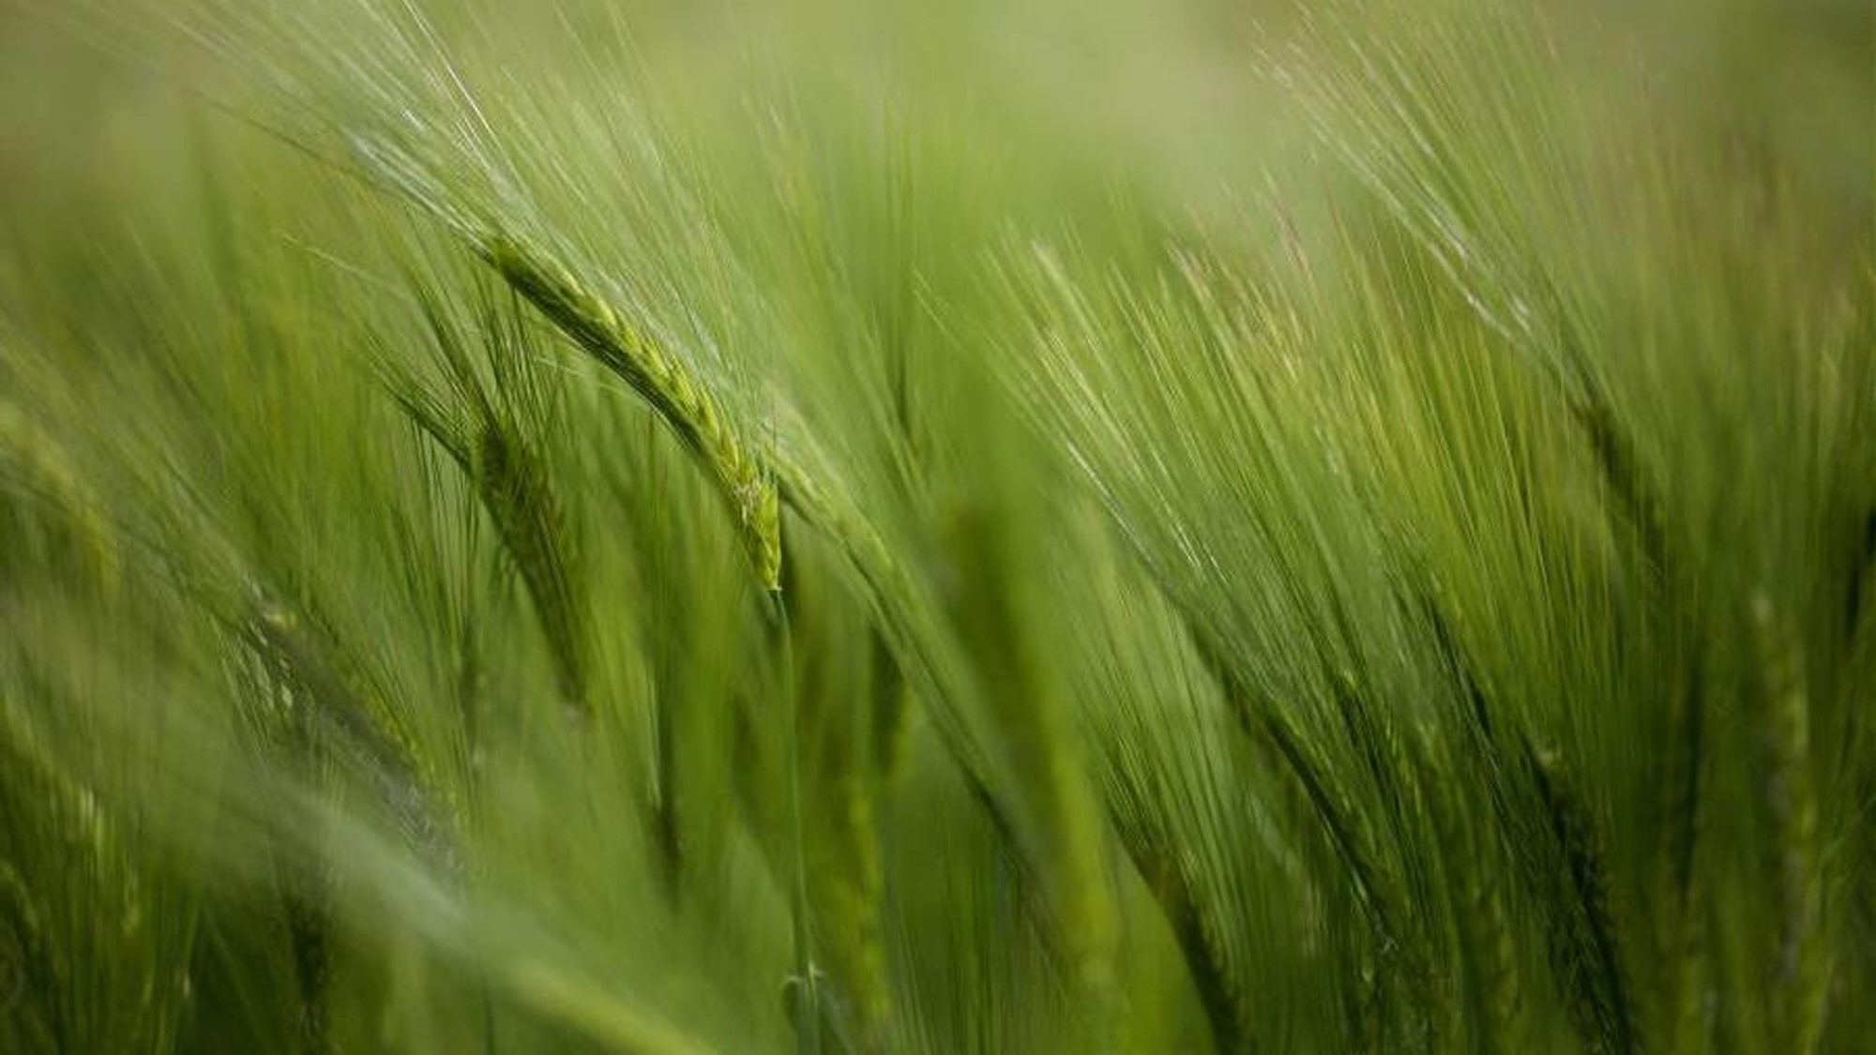
Crop Disease Detection and Crop Suggestion Tool
AI-driven Solutions for Indian Agriculture
Team : SANS.AI

Slide 2

AGENDA
Brief Overview of the Project
Problem Statement
Who are the End-Users
Future Updates
Modelling
Conclusion & Insights

Slide 3
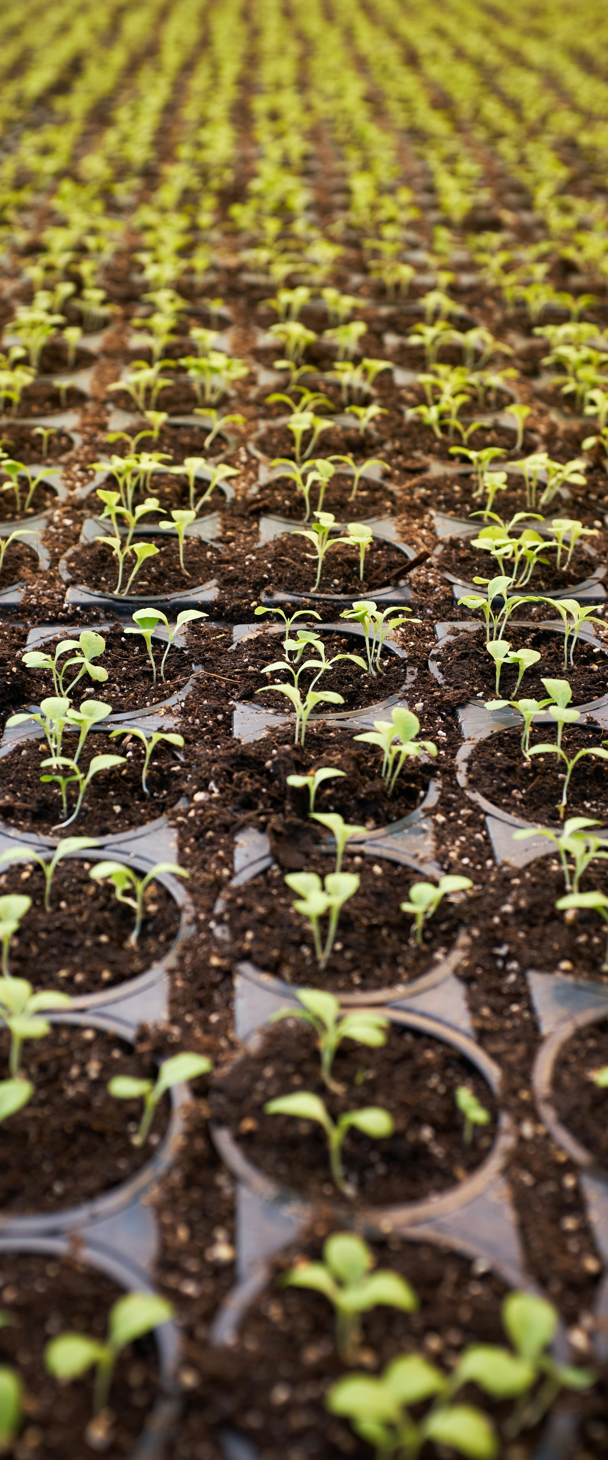
PROJECT OVERVIEW
Agriculture is a critical sector in developing countries like India, where crop diseases and unpredictable weather significantly impact farmers' livelihoods and crop yields.
Traditional methods for detecting crop diseases and selecting suitable crops are often insufficient and inefficient, leading to reduced productivity and increased vulnerability for farmers.
The Crop Disease Detection and Crop Suggestion Tool is an AI-driven platform designed to address these challenges.
By leveraging advanced image recognition technology and real-time weather data, the tool provides farmers with timely and accurate insights for managing their crops more effectively.

Slide 4
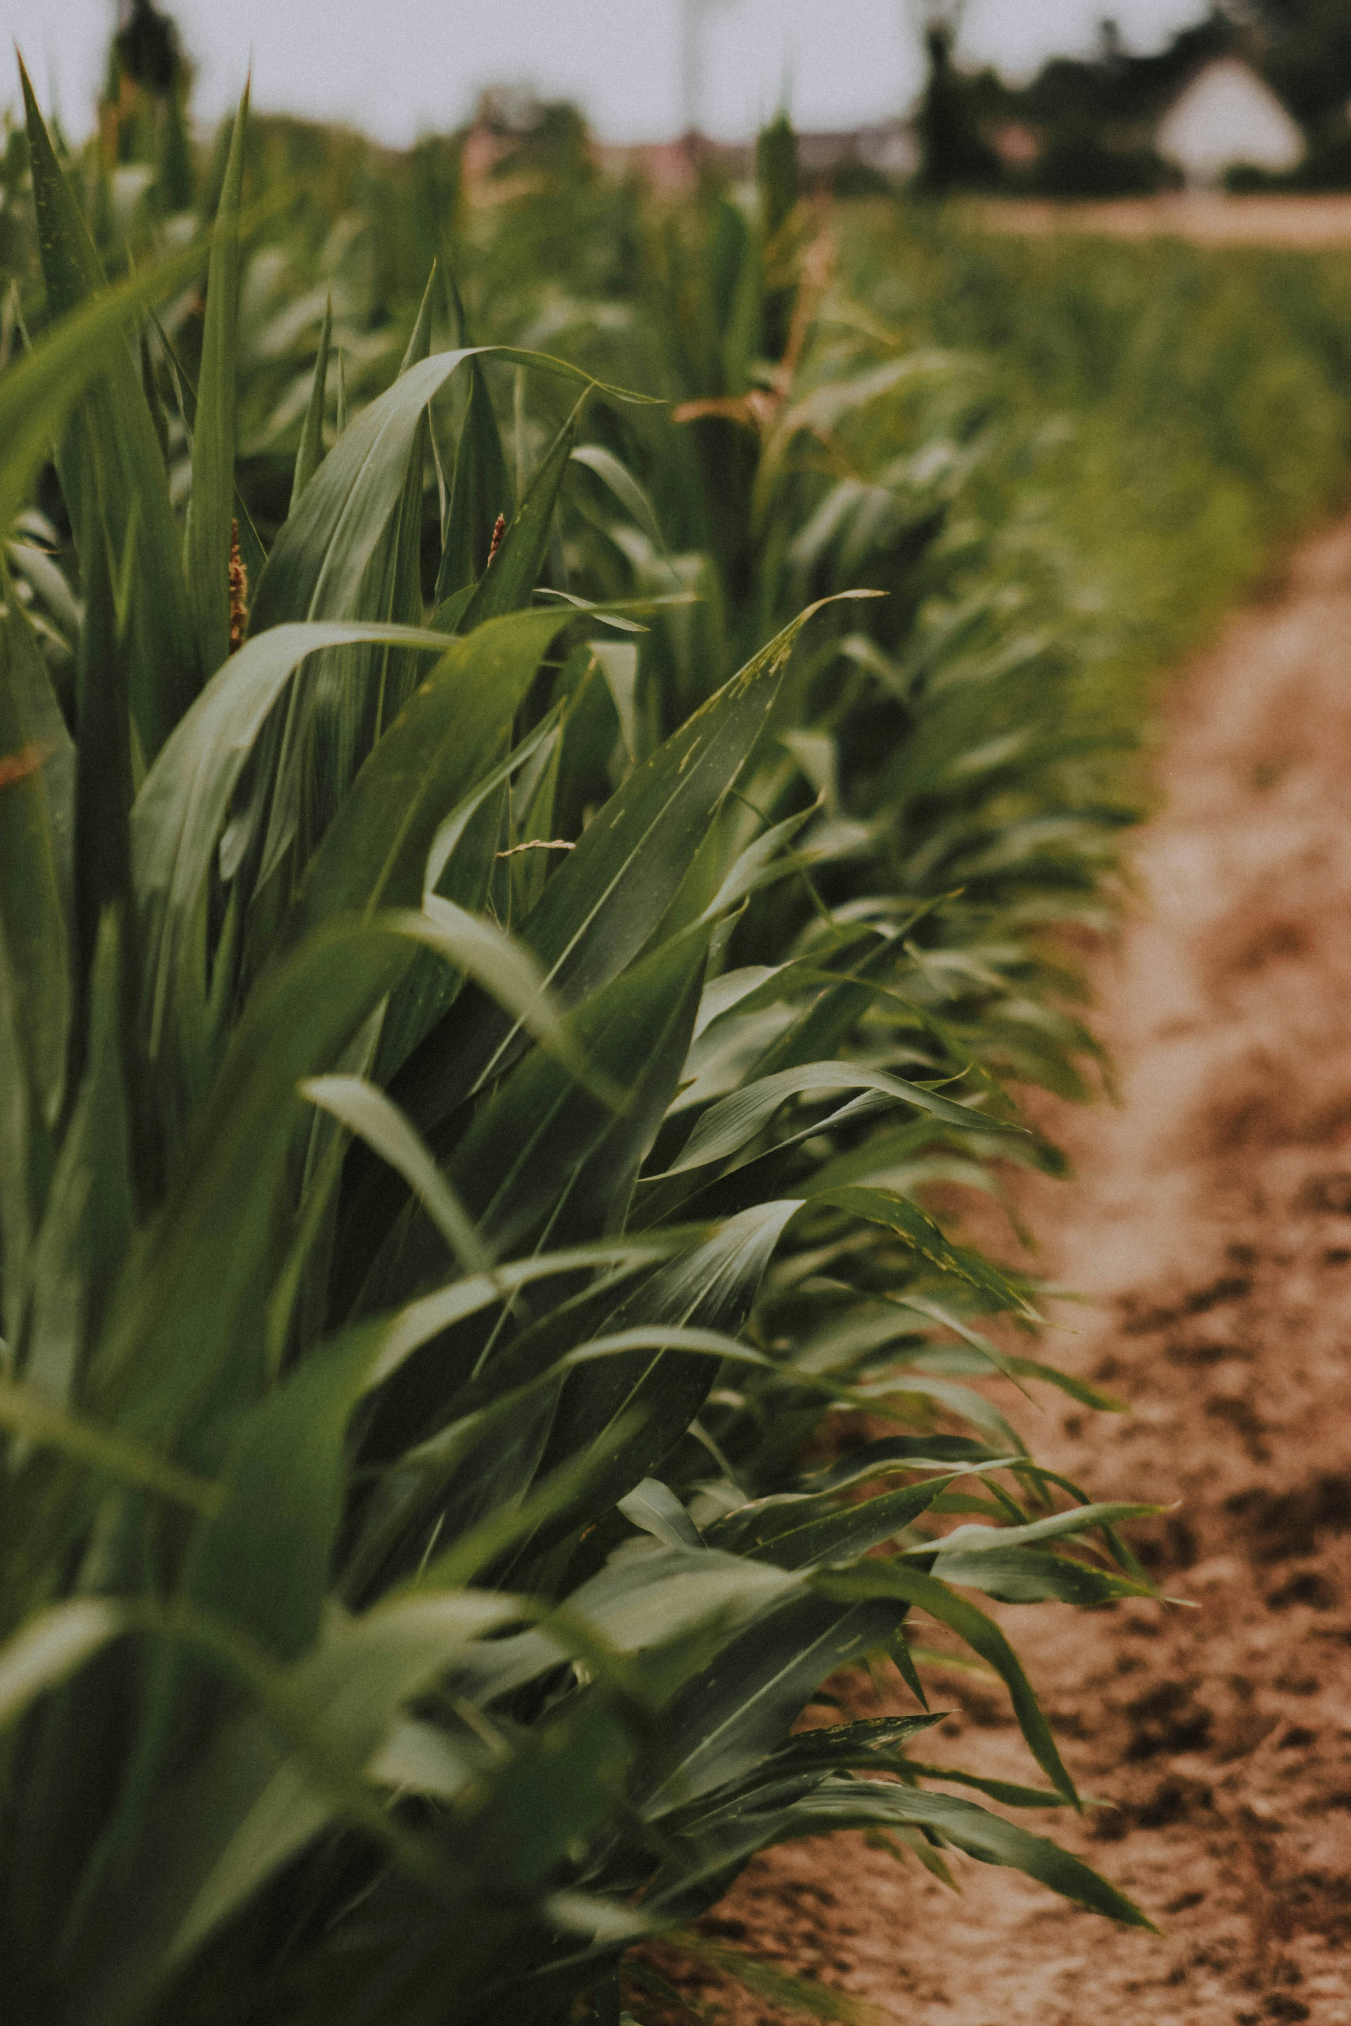
PROBLEM STATEMENT
Crop Diseases : Farmers struggle with detecting crop diseases using traditional methods, which are often slow and inaccurate.
Unpredictable Weather : Farmers lack access to reliable, real-time weather information.
Reduced Agricultural Productivity : The combination of crop diseases and unpredictable weather results in decreased agricultural productivity.
Need for Innovative Solutions : There is an urgent need for advanced tools that provide timely and accurate disease detection.
Weather-informed crop recommendations are essential to help farmers make informed decisions and improve resilience.

Slide 5
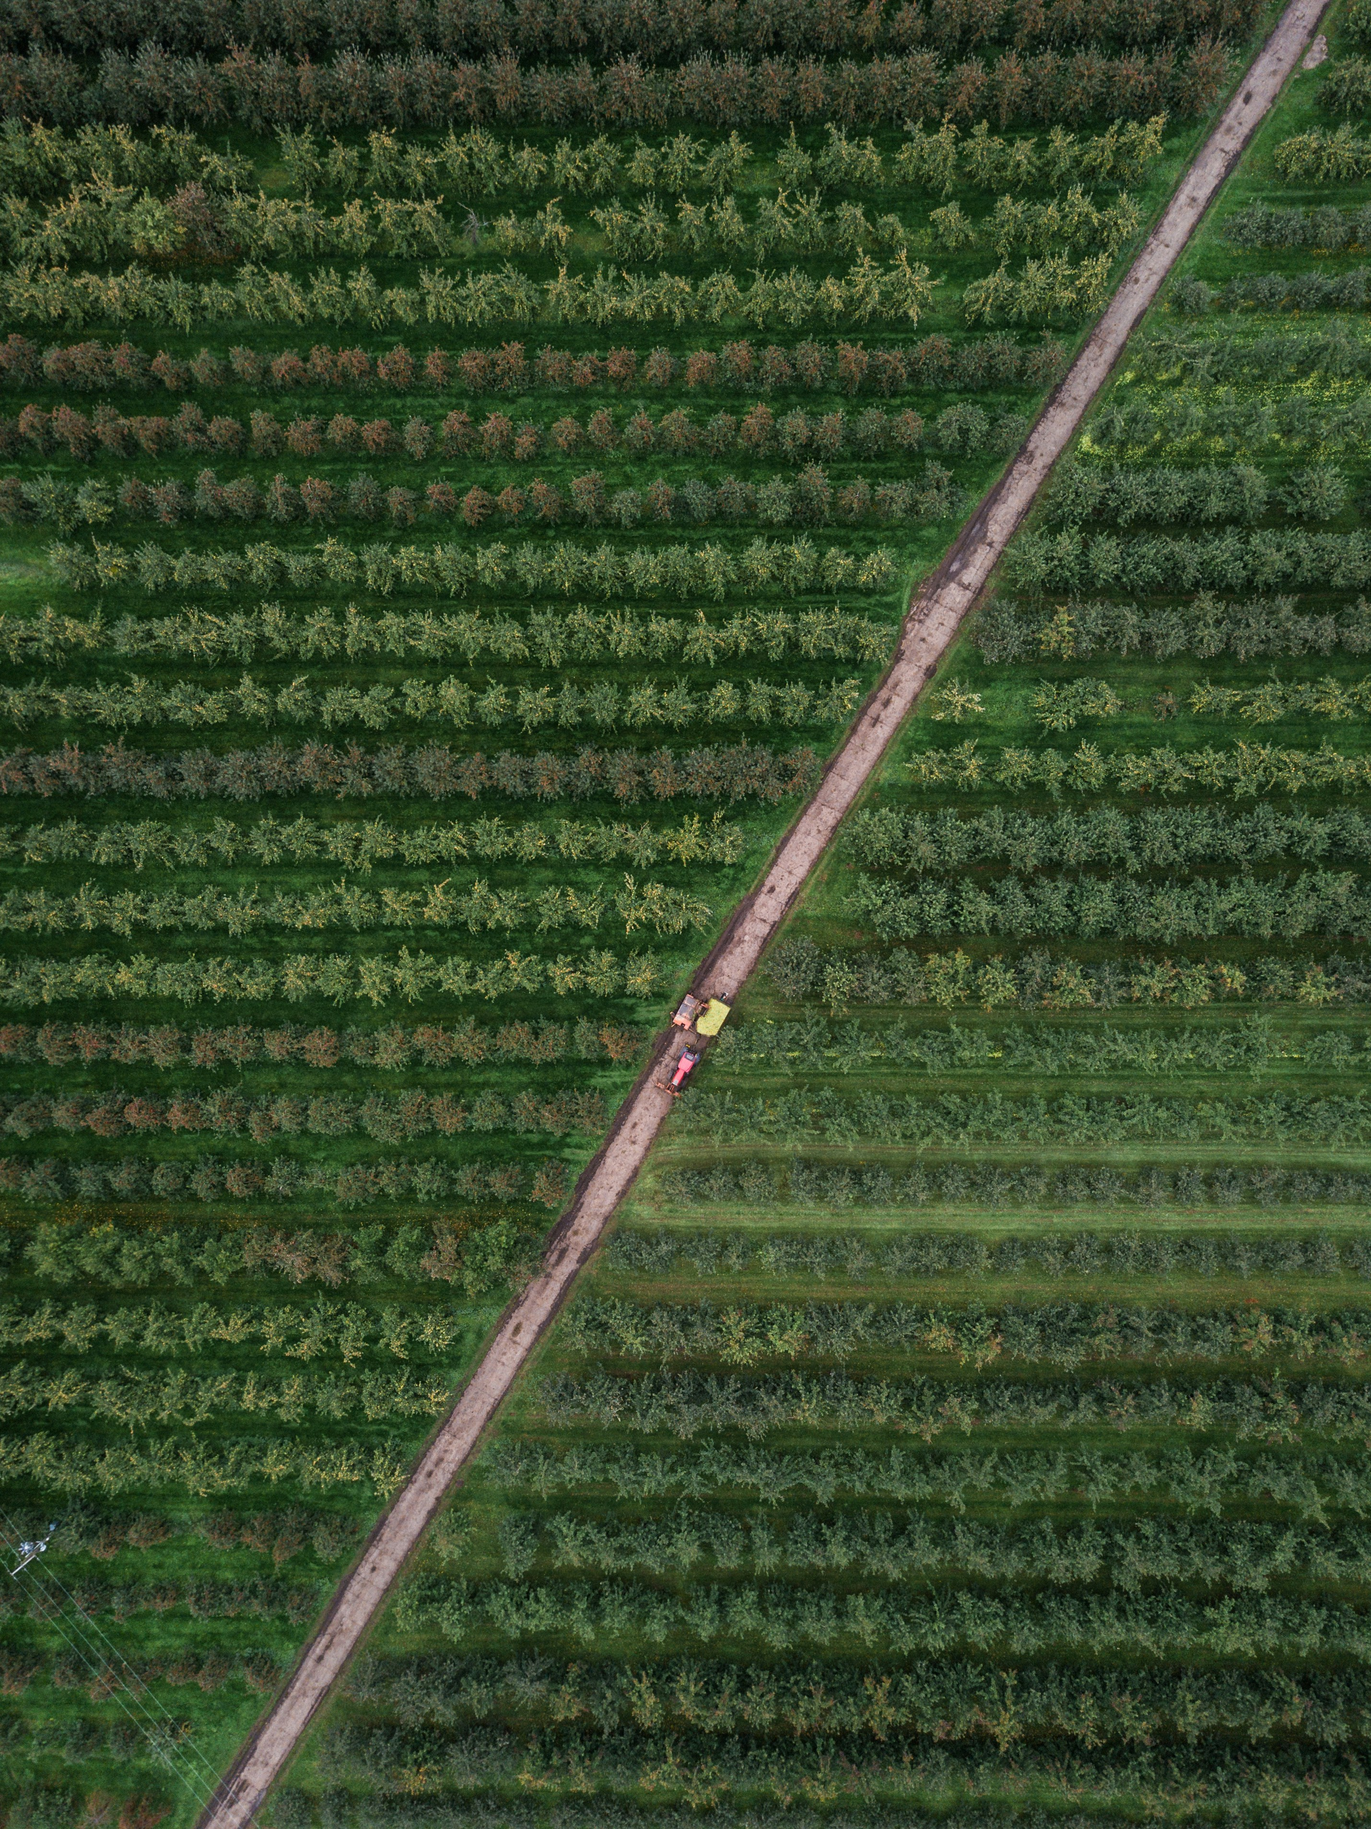
Who are the end-Users
Smallholder Farmers : Primary users who need timely and accurate crop disease detection and weather-based crop suggestions.
Agricultural Extension Workers : Support farmers by providing expert advice and assistance.
Agricultural Researchers : Analyze data to study crop disease patterns and weather impacts.
Government Agencies : Monitor agricultural productivity and food security.
AgriTech Companies : Develop and deploy agricultural technologies.

Slide 6
Future updates
Expanded Disease Database : Extend the disease detection model to cover a wider range of crops and diseases.
Community Feature : Implement a platform for farmers to share experiences, solutions, and best practices.
Predictive Analytics and Alerts : Develop predictive models to forecast disease outbreaks and adverse weather conditions.
Enhanced AI Models : Continuously refine AI algorithms for higher accuracy and faster processing times.
Integration with IoT Devices : Connect the tool with IoT-based sensors for real-time monitoring of crop health and environmental conditions.

Slide 7

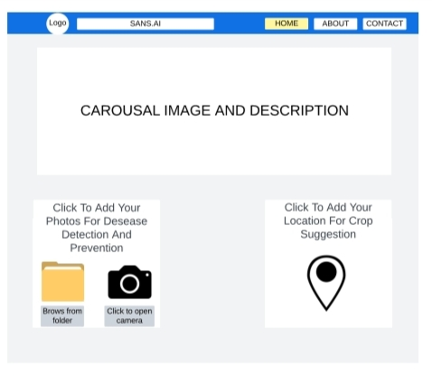
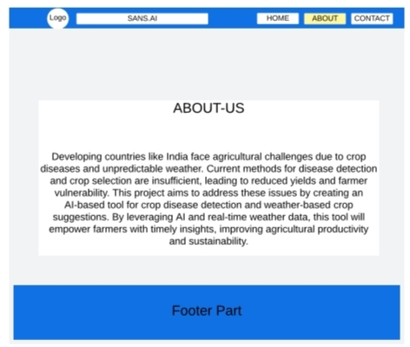
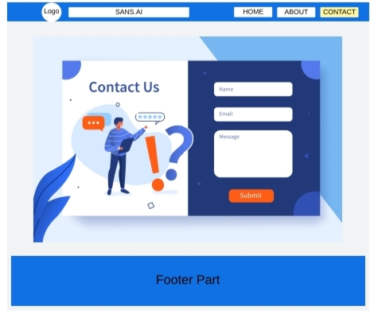
modelling

Slide 8
Conclusion & insights
The AI-driven Crop Disease Detection and Crop Suggestion Tool aims to revolutionize agricultural practices in developing countries like India.
By providing timely and accurate disease detection through image recognition and weather-based crop recommendations, the tool empowers farmers to make informed decisions, ultimately improving crop yields and agricultural productivity.
This innovative solution addresses critical challenges faced by farmers, enhancing resilience and sustainability in agriculture.
Leveraging AI and real-time data empowers farmers with actionable insights, enhancing crop management and reducing losses.
The tool's adaptability and potential for future enhancements ensure it remains relevant and effective across diverse agricultural contexts.
By fostering a collaborative community and expanding its reach, the project can drive significant improvements in global agricultural practices.

